Slide 1

Welcome
Notes:
Welcome slide.

Slide 2
Introduction
Teacher’s Identity
Md. Hasan Hafizur Rahman
Lecturer &
Head of the Department (English), Campus-5
Cambrian School & College
Dhaka.
Lesson’s Identity
Class-VIII
English 2nd Paper
Grammar
Notes:
Introduction.

Slide 3
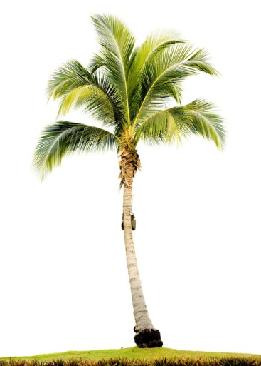
Upper Part
A complete tree
Lower Part
Notes:
A tree has two parts.

Slide 4
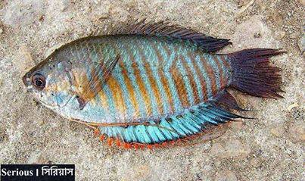
Front part
Back part
A complete fish
Notes:
Two parts shown of the fish.

Slide 5
First part
2nd part
The war of 1971
brought our freedom.
Sentence
Notes:
Two parts of a sentence shown.

Slide 6
What do you mean by the image and text?
Sentence and its parts.
Notes:
Taking out the subject of today’s class.

Slide 7
Our today’s lesson is-
Part of a sentence
Unit-1, Lesson-1
Notes:
Lesson declaration.

Slide 8
Learning outcomes
After studied this lesson, we will be able to---
define sentence
know the parts of a sentence
identify the parts of a sentence
to match subject and predicate
Notes:
Target to achieve from this lesson.

Slide 9
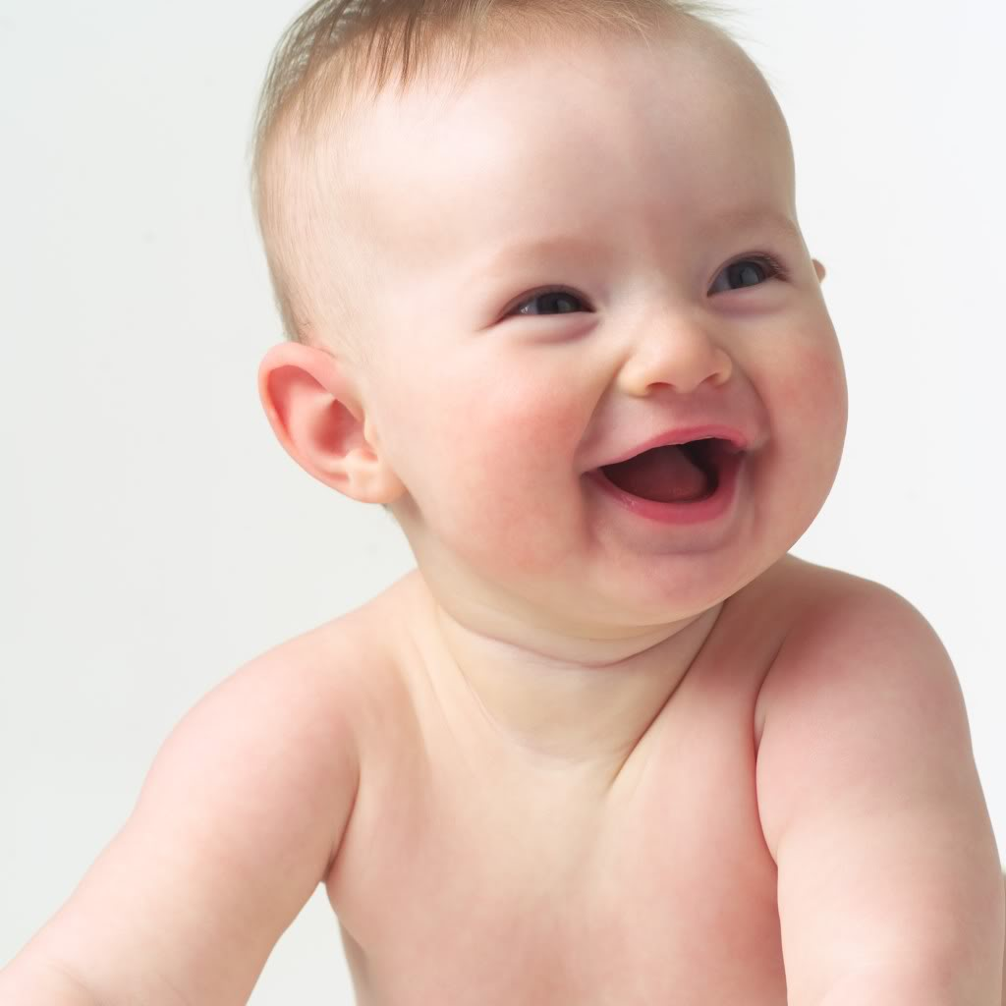
A baby laughs.
Notes:
Subject and predicate.

Slide 10
Babies are laughing.
Three babies are laughing.
Notes:
Just to engage the students teacher may ask questions, who are laughing? How many are laughing?

Slide 11
Follow
First part
2nd part
Three babies
are laughing.
Subject
Sentence
Predicate
Notes:
How sentence is formed with two parts.

Slide 12
So we can see, there are two parts of a sentence.
Sentence
Subject
Predicate
Notes:
Diagram of subject & predicate.

Slide 13
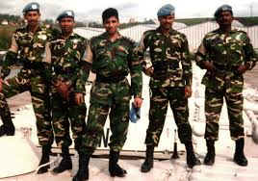
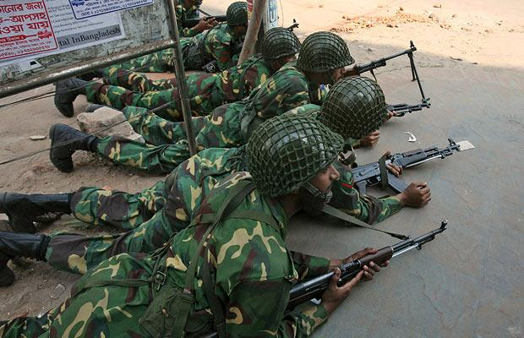
1. Soldiers
fight.
2. Our soldiers
fight hard battles.
Notes:
Showing subject & predicate.

Slide 14
Subjects
Soldiers
Our soldiers
Subject may be a single word or more than a single word.

Slide 15

We can find out a subject by asking a question to verb with ‘who’ or ‘what’.
Soldiers fight.
Follow
Our soldiers fight.
Who fight?
1. Soldiers
2. Our soldiers
So, they are subjects.
Notes:
How to find out subject.

Slide 16
Follow again
Soldiers fight.
What do soldiers do?
Our soldiers fight.
What do our soldiers do?
Predicates
fight.
fight hard battle.
Predicate also may be a single word or more than a single word.

Slide 17
We can find out a predicate asking question to subject about his activity (What does the subject do?)
What do the subjects do?
fight.
fight hard battle.
So, they are predicates.
Notes:
How to find out predicate.

Slide 18
Always remember
A subject always contains a person or a thing or equivalent of a person or a thing.
A predicate always contains a verb along with other words.
Notes:
Content belonging to subject & predicate.

Slide 19
Let us practice some subjects & predicates.
Subject | predicate
Birds | fly.
Birds | fly in the sky.
Some birds | don’t fly in the sky.
Good boys | are always punctual.
The little child | is sleeping.
To err | is human.
Our class captain | is a brilliant student.
It | is terrible.
You | have done well.
You | love your enemies.
God | may have mercy on us.
Notes:
Teacher may ask individually to engage the students.

Slide 20
Oral Test (Individually)
Notes:
Practice.

Slide 21
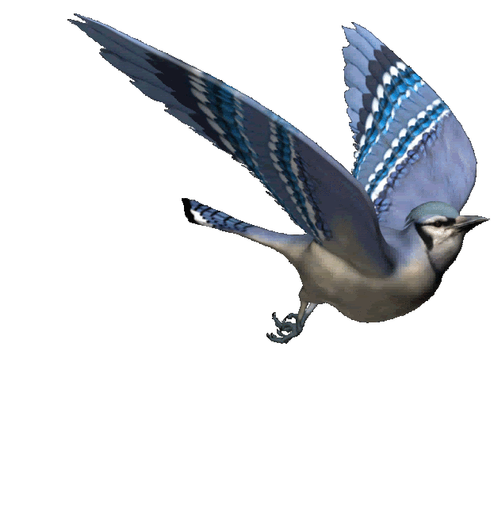
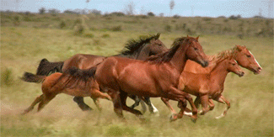
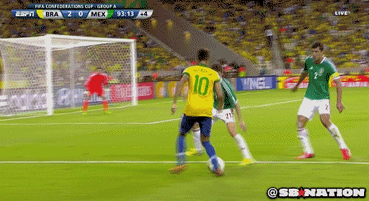
Fill up the box with subjects & predicates.
Subject | Predicate
Notes:
Class activities.

Slide 22
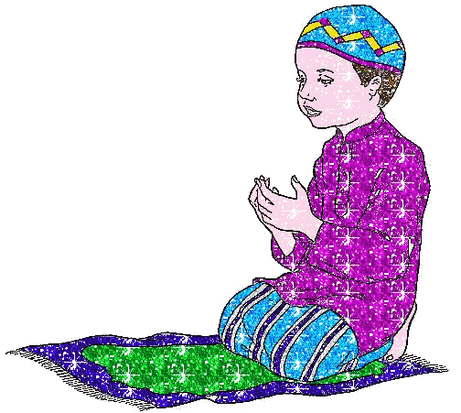
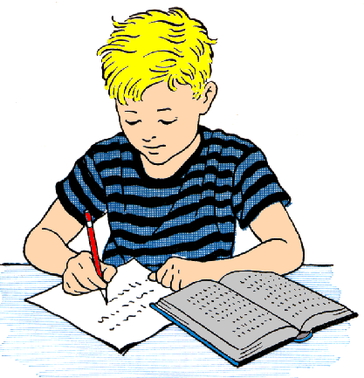
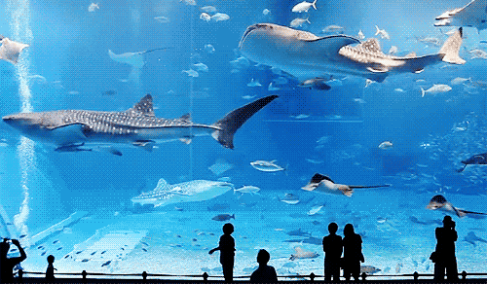
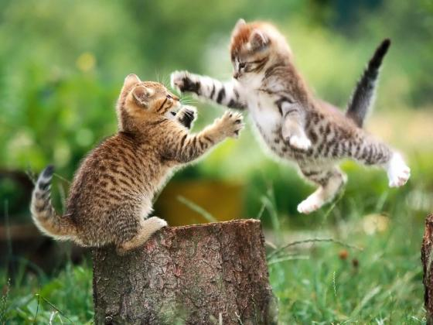
Subject | Predicate
Notes:
Class activities.

Slide 23
Evaluation
Separate the subject & predicate:
God is the Almighty.
He has created us.
A blind man cannot see anything.
Barking dogs seldom bite.
A thing of beauty is joy for ever.
No man can serve two masters perfectly.
Seven days make a week.
Let us go for a picnic.
Our heroic soldiers fought bravely against our enemies.
All the members of our family went to the zoo.
Notes:
Feedback of this class.

Slide 24
Home Work
Match the number in column B with the letters in column A and write complete sentences (Text Book Page No-03).
Sl | A | Sl | B
a. | Industry | i. | howls at night.
b. | A man of will | ii. | cannot stand.
c. | An eagle | iii. | is a bird of prey.
d. | A mad dog | iv. | may bite anybody.
e. | The wolf | v. | succeeds in life.
f. | A house divided itself | vi. | is the mother of good luck.
g. | Birds | vii | is required for the post.
h. | Thirty of the tender aged boys | viii | spoke in a clear voice.
i. | A young man of character | ix. | fly at large in the sky.
j. | The leader of the party | x | are playing in the field.
Notes:
Assignment at home.

Slide 25
all.
May Allah bless you
Notes:
Ending of the lesson.

Slide 26
Acknowledgement
We would like to express our cordial gratitude to the Ministry of Education, Directorate of Secondary & Higher Education, NCTB, A2i and the panel of honorable editors ( Md. Jahangir Hasan, Assistant Professor (English) TTC, Rangpur, Ranjit Poddar, Associate Professor (English) TTC, Dhaka, and Urmila khaled, Assistant Professor (English) TTC, Dhaka, to enrich the contents.

